Slide 1
Dairy cattle production (95314)
Dr Jihad Abdallah
Topic 11:Important diseases of dairy cows

Slide 2
Sources of lecture
Dairy Co Technical Information. Mastitis in dairy cows. http://www.dairyco.org.uk/technical-information/animal-health-welfare/mastitis/
A. SHARIF AND G. MUHAMMAD. 2009. MASTITIS CONTROL IN DAIRY ANIMALS; Pakistan Vet. J., 2009, 29(3): 145-148. http://www.pvj.com.pk/pdf-files/29_3/145-148.pdf
Milk Fever (Hypocalcaemia) in Cows. Note Number: AG0067. Revised by David Champness, Hamilton http://www.dpi.vic.gov.au/agriculture/pests-diseases-and-weeds/animal-diseases/beef-and-dairy-cows/milk-fever-hypocalcaemia-in-cows

Slide 3
Mastitis
Mastitis is the inflammation of the mammary gland and udder tissue, and is a major endemic disease of dairy cattle.
It usually occurs as an immune response to bacterial invasion of the teat canal by variety of bacterial sources present on the farm, and can also occur as a result of chemical, mechanical, or thermal injury to the cow's udder.
Milk-secreting tissues and various ducts throughout the udder can be damaged by bacterial toxins, and sometimes permanent damage to the udder occurs.
Severe acute cases can be fatal, but even in cows that recover there may be consequences for the rest of the lactation and subsequent lactations.

Slide 4
Mastitis
Mastitis is most often transmitted by contact with the milking machine, and through contaminated hands or other materials, in housing, bedding and other equipment.
Most of the cases of mastitis occur in lactating cows, often soon after calving.
The most common causative organisms of udder disease include: Staphylococci (S. aureus and Staph. epidermidis), Streptococci (Str. agalactiae, Str. dysgalactiae, Str. uberis and Str. bovis) and coliforms (mainly E. coli and Klebsiella pneumoniae). Other less frequent agents include: Pseudomonads, Nocardia, Mycoplasma and yeast

Slide 5
Control of mastitis
Close attention to milking hygiene,
The first streaks of milk should be observed for presence of clots, streaks of blood, milk may be off color or watery, all these indicate presence of mastitis.
Post milking teat dipping in an antiseptic solution helps in the prevention of mastitis,
Culling of chronically-infected cows,
Good housing management
Effective nutrition to promote good cow health are essential in helping to control herd mastitis levels.
Treatment of dry cows with antibiotics showed 82% reduction in the rate of new intra-mammary infections in the dry period

Slide 6
Milk Fever
Milk fever is a disorder mainly of dairy cows close to calving. It is a metabolic disease caused by a low blood calcium level (hypocalcaemia). Affects 3% to 10% of cows per year
Economic losses are due to deaths (about one in 20 affected cows), a reduction in the productive lifespan of each affected cow of about three years, and reduction in milk production, as well as costs of prevention and treatment.

Slide 7
Milk Fever
Signs:
Cows show agitation and a tremor in muscles of the head and limbs. Then they stagger and go down to a "sitting" position, often with a 'kink' in her neck, and finally lie flat on their side before circulatory collapse, coma and death.
A dry muzzle, staring eyes, cold legs and ears, constipation and drowsiness are seen after going down. The heart beat becomes weaker and faster. The body temperature falls below normal, especially in cold, wet, windy weather.
These signs are due mainly to lowered blood calcium levels. Sometimes there are additional signs due to complicating factors. Bloat is common in cows unable to "sit up" because the gas in the rumen is unable to escape. Pneumonia and exposure may affect cows left out in bad weather.

Slide 8
Milk Fever
Causes:
About 80% of cases occur within one day of calving because milk and colostrum production drain calcium (and other substances) from the blood, and some cows are unable to replace the calcium quickly enough.
High producers are more susceptible because the fall in their blood calcium level is greater. Some individual cow families or breeds (for example, Jerseys) are more susceptible than others.
Age is important. Heifers are rarely affected. Old cows increase in susceptibility up to the fifth or six calving because they produce more milk and are less able to replace blood calcium quickly.

Slide 9
Milk Fever
Prevention:
The feeding management of dry cows in the 2 weeks before calving is very important, because it affects both the amount of calcium available to replace blood calcium and the efficiency with which the available calcium can be used.
When the amount of calcium in the diet is greater than is needed, the efficiency of absorbing calcium from the intestine and the efficiency of transferring calcium from the skeleton both become very sluggish and the chance of milk fever is greatly increased.

Slide 10
Milk Fever
Feeding hay prior to calving and restricting access to green feed results in acidic blood which favors calcium mobilization from bone and improves calcium absorption from the intestines, both of which are important factors in preventing the occurrence of milk fever.
Fat cows are at a greater risk than thin cows. This is partly because their feed and calcium intake has been higher and partly because fat cows produce more milk at calving time.
In early lactation, cows should receive as much calcium as possible, and clover-dominant pasture are therefore desirable. They will help to prevent grass tetany as well as milk fever.

Slide 11
Milk Fever
Treatment:
Treatment should be given as soon as possible. Use 300 ml, or more, of a 40% solution of calcium borogluconate or, preferably, a combined mineral solution such as "three-in-one" or "four-in-one". Often 600ml may be required.
The combined solutions contain additional ingredients such as magnesium, phosphorus and dextrose (for energy), which may also be at low levels in the blood while cows have milk fever
Recovered cows should not be milked for 24 hours; then the amount of milk taken should be gradually increased over the next 2-3 days.

Slide 12
Milk Fever
Management of the diet can be a valuable aid preventing milk fever. Cows should be kept on a low calcium diet while they are lactating (dry).
This stimulates their calcium regulatory system to keep the blood levels normal by mobilizing the body stores of calcium from the bone.
When the demand for calcium increases at calving, calcium can be mobilized much more rapidly from bone than the feed, therefore preventing milk fever.

Slide 13
With cows at greater risk - Jersey cows of mature age and in forward to fat condition - green feed should be restricted and plenty of hay fed for at least 1-2 weeks before calving. Neither should contain a high percentage of clover or capeweed.
If it is necessary to improve the body condition of cows in order to improve milking performance, feeds high in energy but low in calcium may be used, for example cereal grain or oaten hay. Cereal grain is also high in phosphorus content, and this is of additional value.
On the point of calving, and afterwards, the available feed and calcium should be unrestricted. Calcium feed supplements may be helpful at this point, but should not be given earlier

Slide 14
Vitamin D3 given by injection 2-8 days before calving may be useful
A common treatment used to prevent milk fever is the injection of calcium borogluconate just before or just after calving. Some cows are given more than one treatment. This is quite successful because the calcium provides a reservoir to increase blood calcium just at the time it is needed for milk and colostrum. The danger is that it may not last long enough and milk fever may still occur before the calcium-regulating mechanism of the cow is working efficiently.

Slide 15
Drenching cows with Unimix on the day before and then twice daily for 1 to 2 days after calving has considerably reduced the incidence of milk fever in some herds where other methods alone have been unsatisfactory. Unimix is a registered product containing a mixture of calcium and magnesium.
Cows that have required injections to treat milk fever will benefit from a drench of Unimix to help prevent relapses.

Slide 16
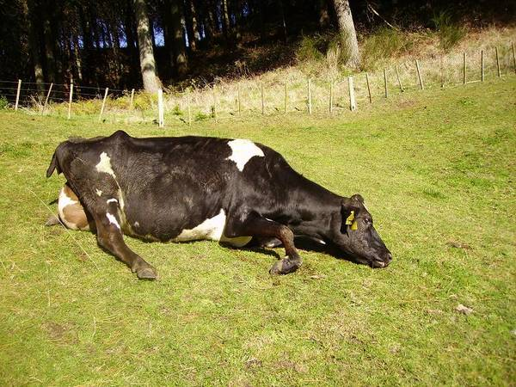

Slide 17
http://www.youtube.com/watch?v=F85cuRuQjLE

